Slide 1
Supreme Court of Bangladesh
Al Amin Khan
ID: 011 132 152
Kamrul Islam Shakil
ID: 011 132 158

Slide 2
Project Description:
The Supreme Court of Bangladesh is the highest court of law in Bangladesh.
In the front there is a yard of green grass.
In the front of the building view there is a map of Bangladesh.
Top of the building, there are 3 Domes.

Slide 3
Task Allocation:
Al Amin Khan
Kamrul Islam Shakil
Texturing grass, domes, building blocks, windows.
Keyboard function and other coding.
Collecting pictures
Edits pictures

Slide 4
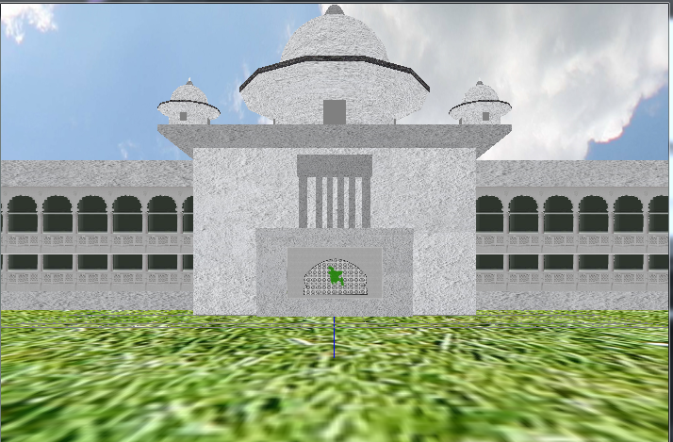

Slide 5
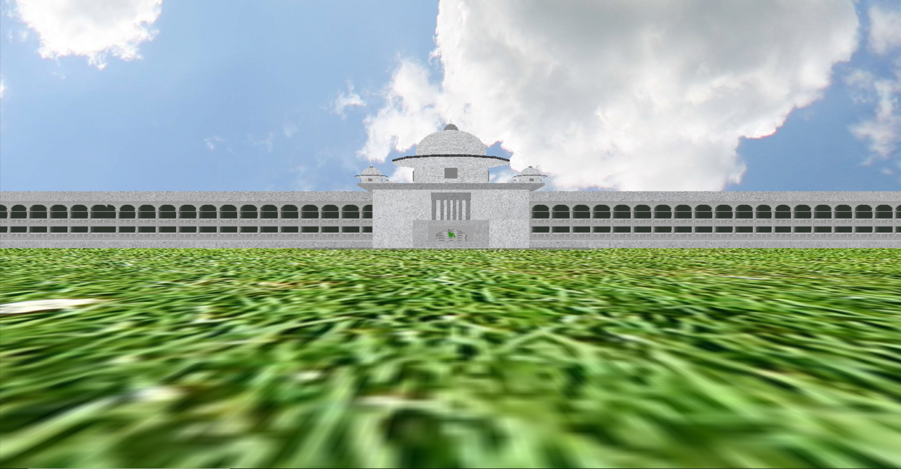
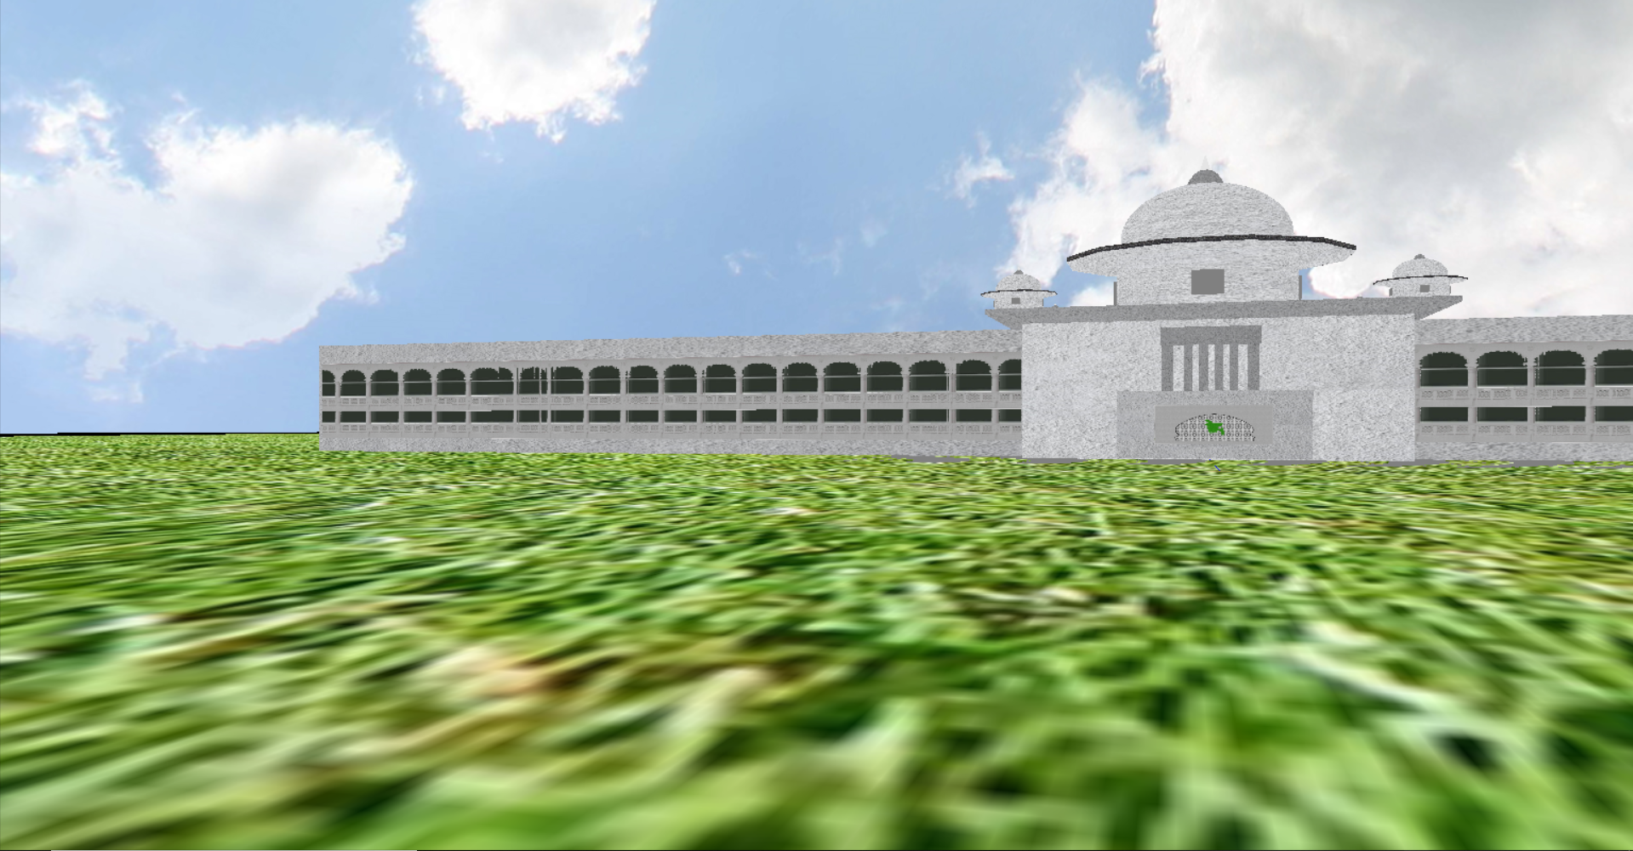
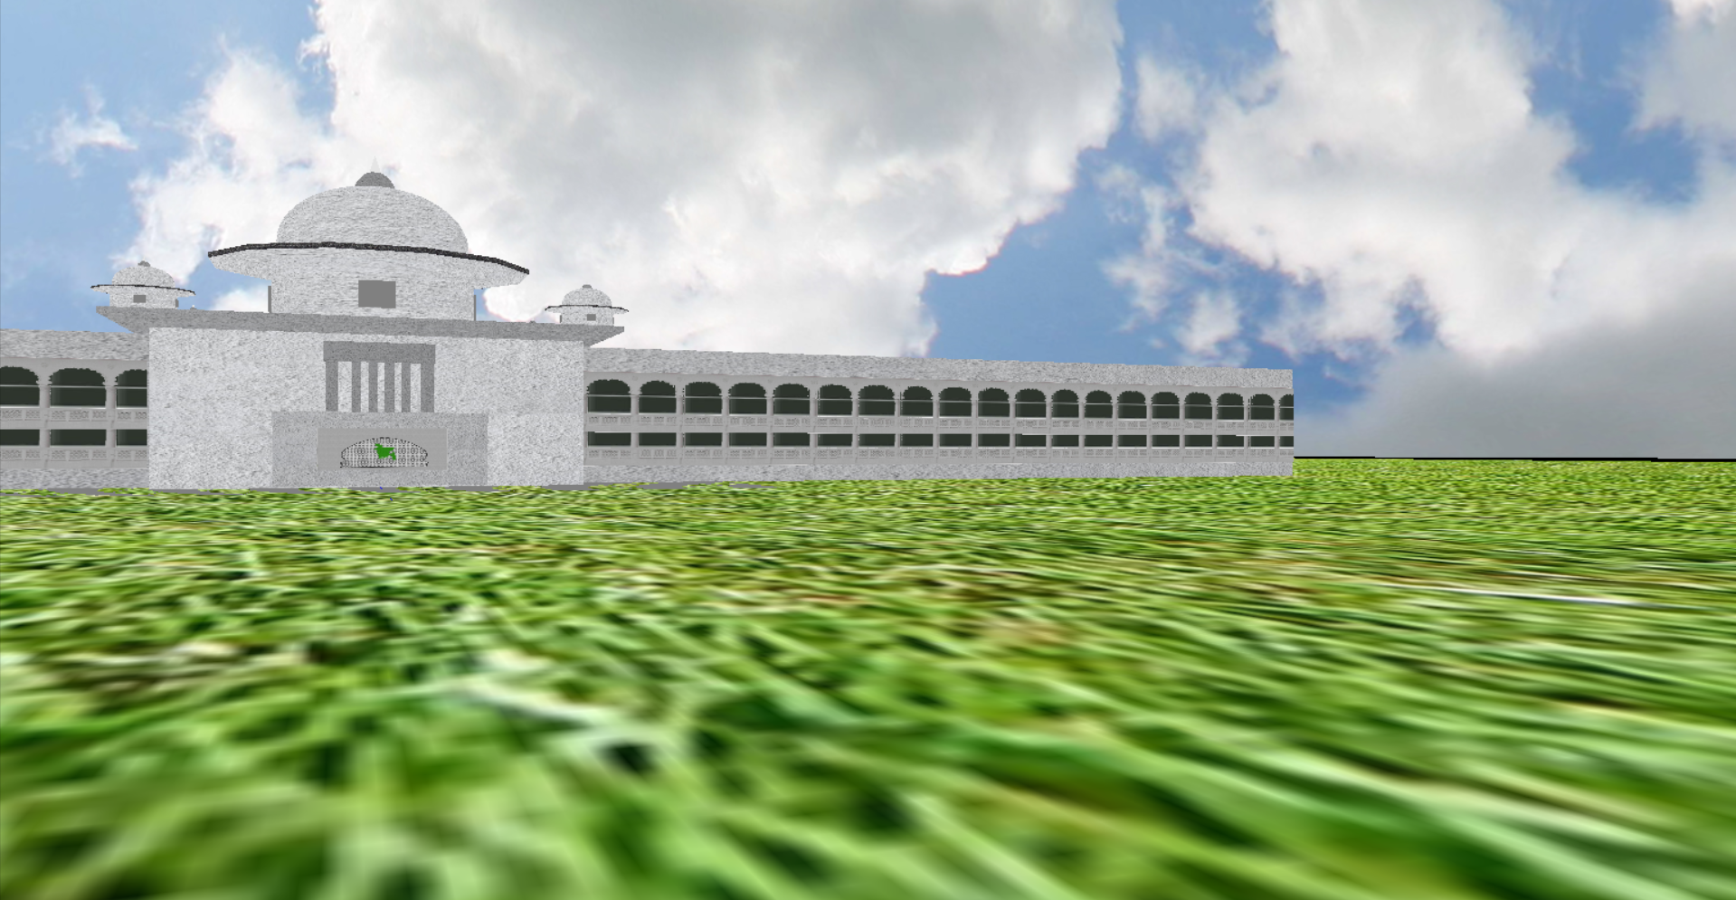

Slide 6
Thank You

